Slide 1
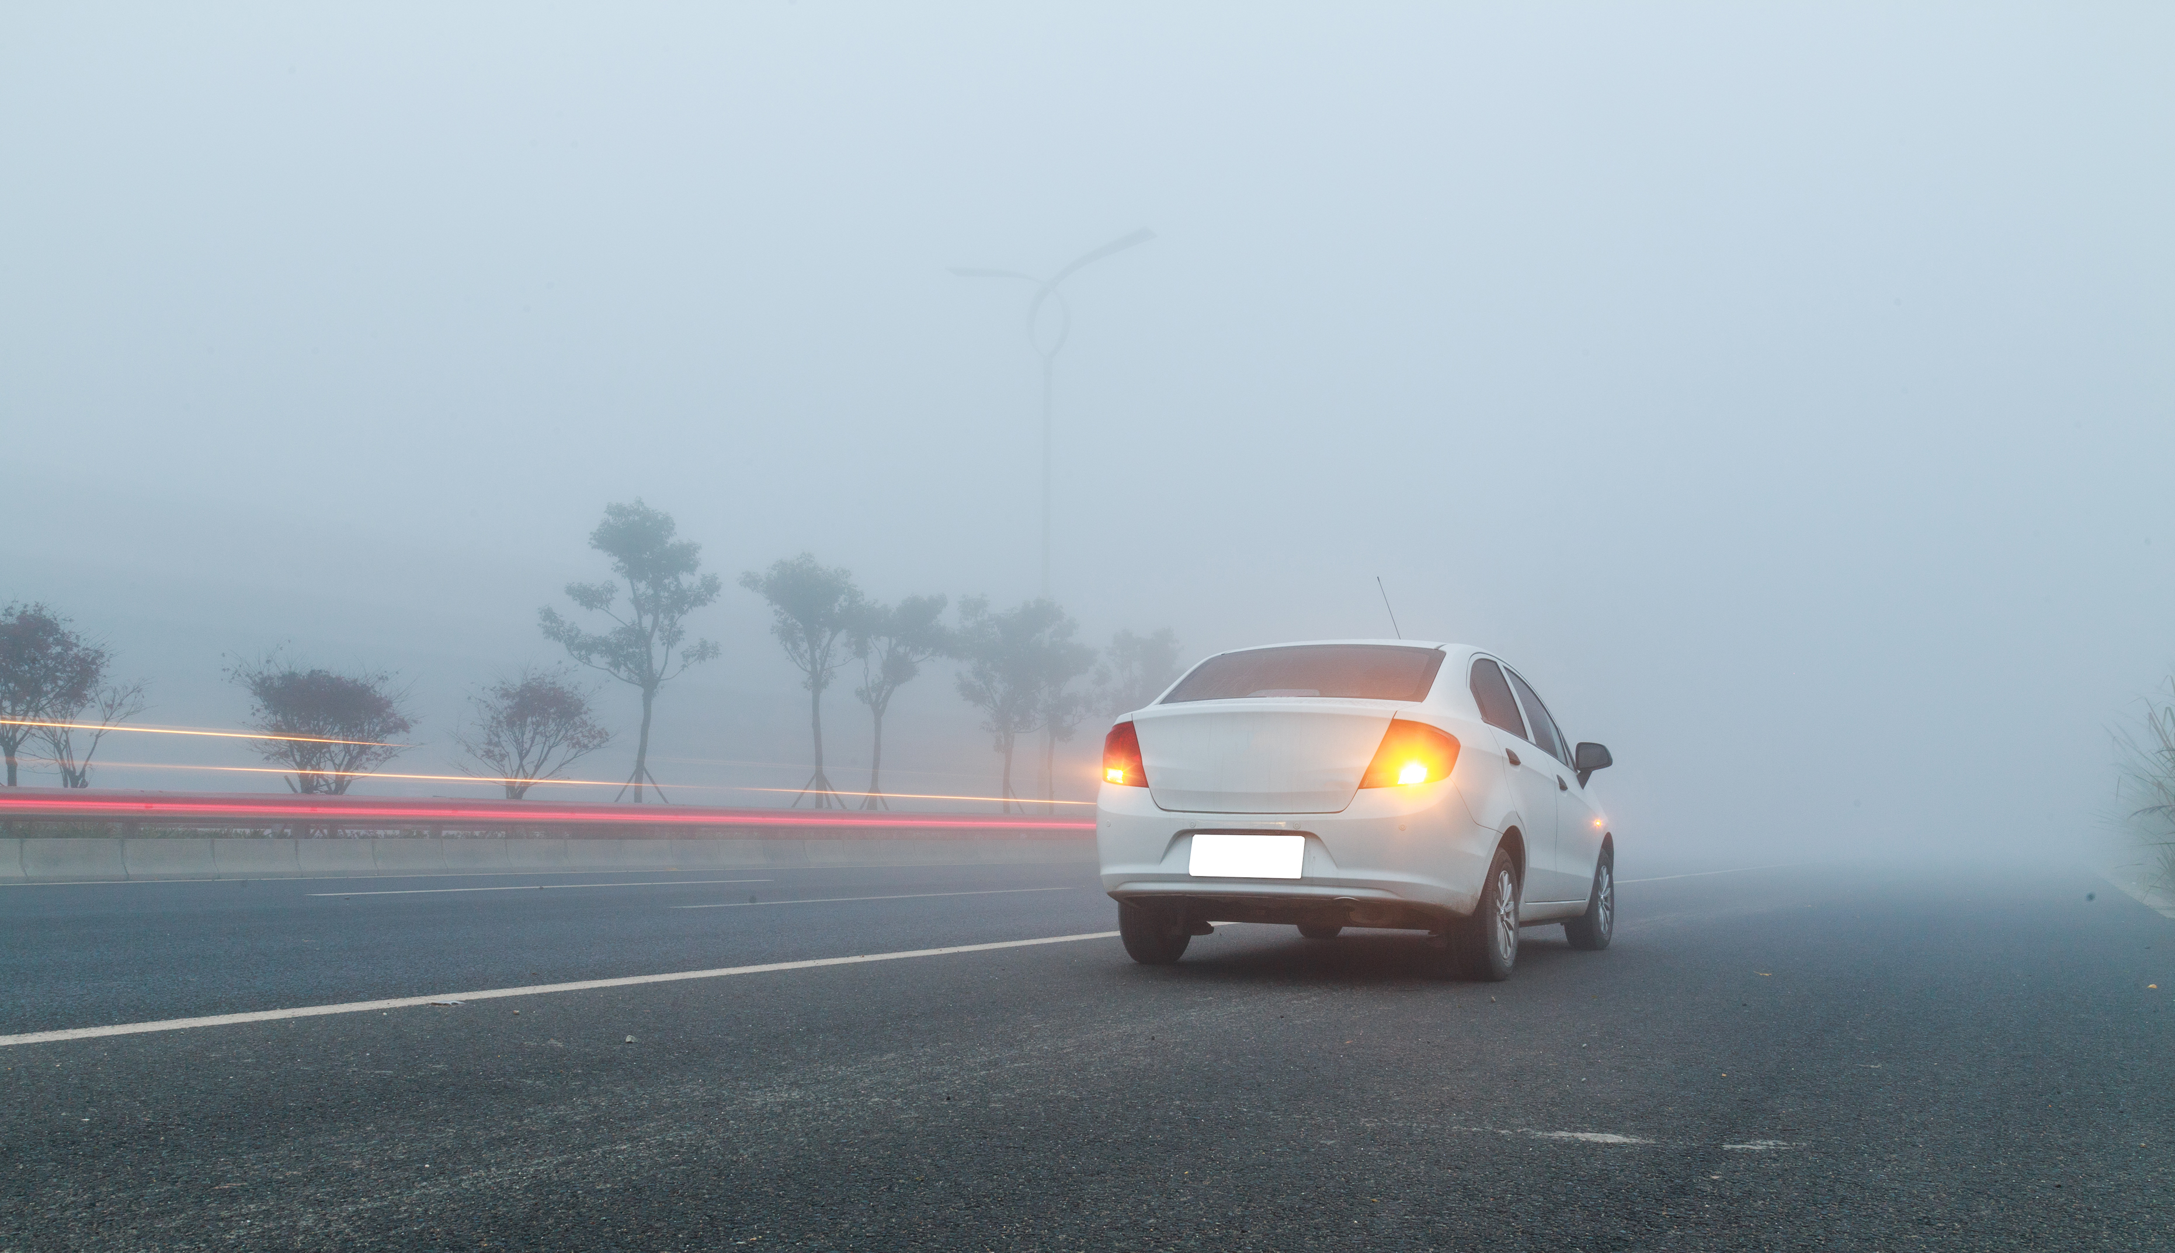
Develop a cost-effective sensor to detect objects while driving in fog.
Develop a cost-effective sensor to detect objects while driving in fog.

Slide 2

The Nerd Herd:
Team members Names | Engineering Specialisation | Graduating year | College Names
SAURABH LODHI | COMPUTER SCIENCE & ENGINEERING | 2024 | CHANDIGARH GROUP OF COLLEGES COE LANDRAN MOHALI PUNJAB
Confidential

Slide 3
Tell us a bit about yourself
 | [Member 1 name] | [Member 2 Name] | [Member 3 Name]
ONLINE ATTENDENCE SYSTEM, REVENUE COLLECTION ON MONUMENT SITES, SINGLE PLATFORM FOR THE TECH STUDENTS | SAURABH LODHI
Past Hackathon experiences SIH(SMART INDIA HACKATHON) | SIH(SMART INDIA HACKATHON 2022), SUNHACK’S INTERNATION HACKATHON 2022(SANDIP UNIVERSITY NASHIK INDIA) IDEA_IGNITION BY CGC LANDRAN 2022, IDEATHON AT NATIONAL SCIENCE DAY 2023
Accolades or awards that you have received | SHORTLISTED AT NATIONAL LEVEL
Other details (If any) | ONINE ATTENDENCE SYSTEM FOR GOVERNMENT AIDED SCHOOLS MAHARASHTRA INDAI, TO PROVIDE A PREPLANED JOURNY AND INFULIENCE THE VISITOR AT THE MONUMENT SITES

Slide 4
Develop a cost-effective sensor to detect objects while driving in fog.
The visibility sensor enhances safety in low-visibility conditions like fog by using radar, LiDAR, ultrasonic, infrared, and camera technologies to detect nearby obstacles and provide real-time information to the driver. Sensor fusion combines data from multiple sources for accurate object detection. The cost-effectiveness is achieved through off-the-shelf components, mass production, and efficient processing with microcontrollers. Extensive testing ensures reliability and accuracy. It communicates warnings and alerts through the vehicle's human-machine interface.
Process Flow (if applicable)
"Urgently needed is an automatic deactivation of the fog tail light“
"Because fog is not detected by the sensors the automatic driving lights are not activated and daytime running lights without tail lights do not suffice.“
"The automatic driving lights do only work in darkness - not with fog or rain“
With automatic driving lights the driving light is often turned off under fog or smog conditions
Driving lights are turned off / day time running lights turned on
Visibility Range Sensor - reliably detects fog or smog conditions
Sensor can be positioned at top or base of windshield
CAUTION! POOR VISIBILITY AHEAD Alert message to driver and other cars on this road (car to x)
Visibility range 50m: fog tail light is turned on

Slide 5
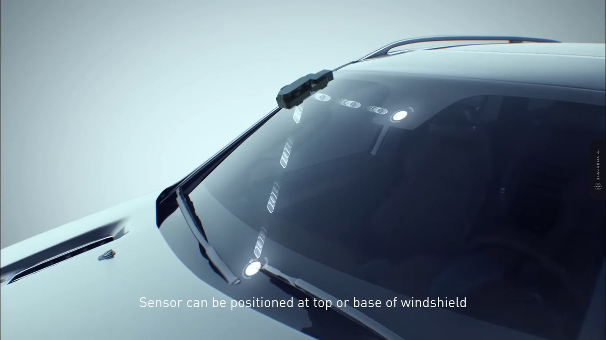
DESIGN & DETAILS

Slide 6
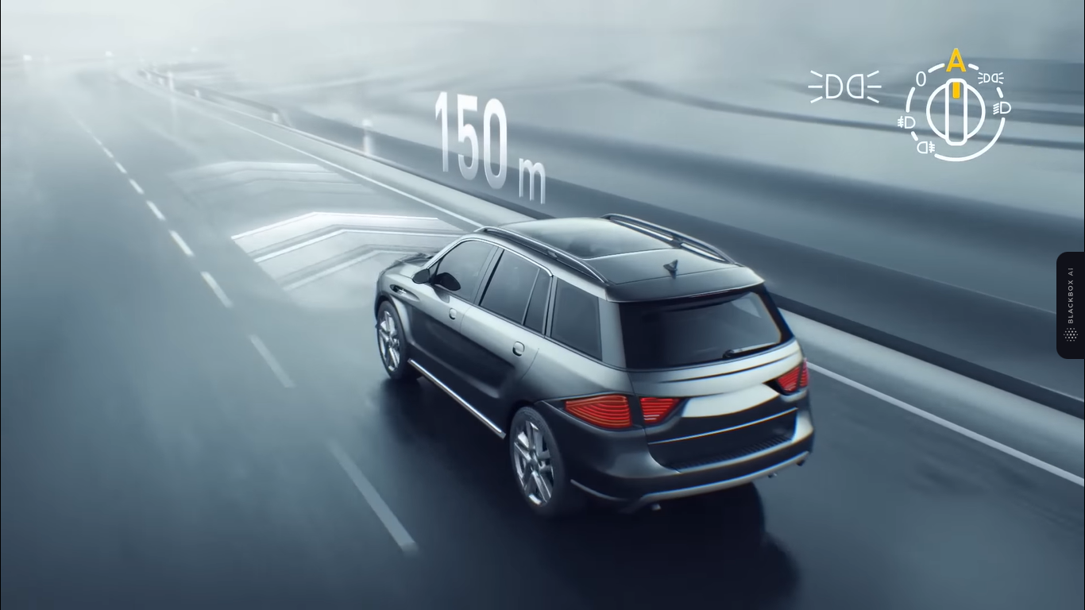
150 METER

Slide 7
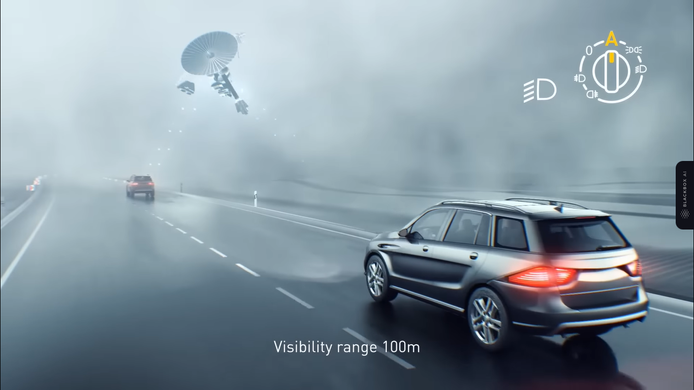
VISIBLITY RANGE 100M

Slide 8
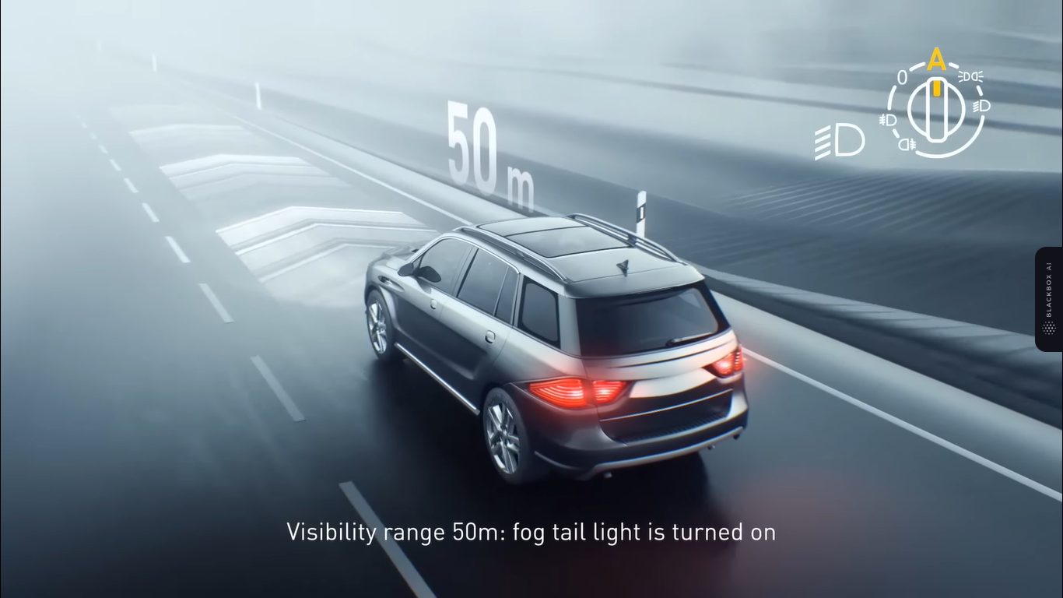
VISIBILITY RANGE 50M: FOG TAIL LIGHT IS TURNED ON

Slide 9
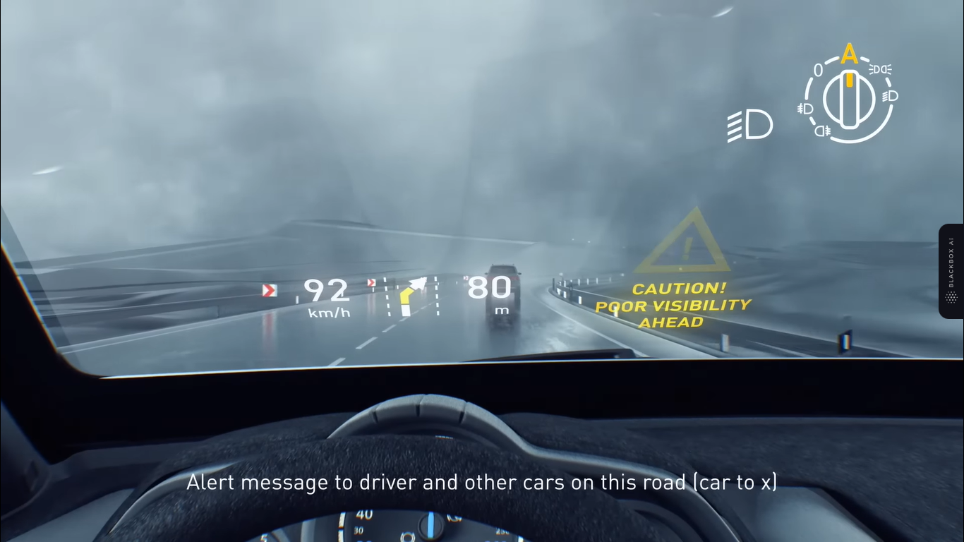
ALTER MESSAGE TO DRIVER AND OTHER CARS ON THIS SIDE[CAR TO X]

Slide 10
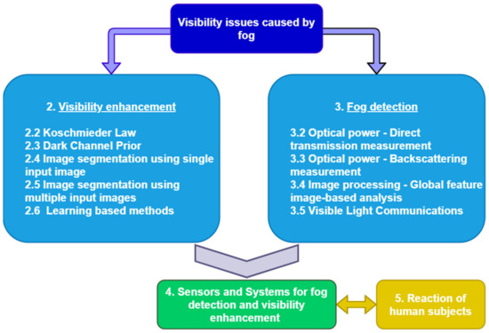
FLOW CHART AND DIAGRAM 1

Slide 11
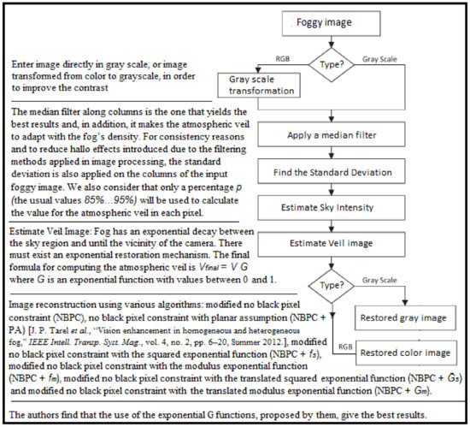
FLOW CHART AND DIAGRAM 2

Slide 12
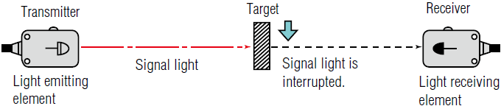
BLOCK DIAGRAM 1

Slide 13
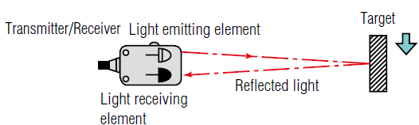
BLOCK DIAGRAM 2

Slide 14
Major Risk and Mitigation
Reduced Accuracy in Dense Fog: Cost-effective sensors may struggle to maintain accuracy in extremely dense fog, leading to false readings and compromised object detection.
Limited Detection Range: Cost constraints may result in sensors with limited detection range, which could hinder the early detection of obstacles at a distance in thick fog.
Interference from Fog Particles: Fog particles may interfere with sensor signals, causing scattering or attenuation, reducing the sensor's effectiveness.
Sensor Calibration Challenges: Calibrating sensors for consistent performance in various fog densities and environmental conditions may be complex and resource-intensive.
Inadequate Data Fusion: Integrating data from different sensor technologies might result in suboptimal data fusion, leading to less reliable object detection.
Cost-Effective Sensor Lifespan: Cost-cutting measures might impact the durability and lifespan of the sensor, potentially leading to premature failure or decreased reliability over time.

Slide 15
Mitigation
Enhanced Sensor Testing: Conduct extensive testing and validation in various foggy conditions and driving scenarios to ensure the sensor's accuracy and reliability. Use real-world data and simulated environments to identify and address potential issues.
Advanced Data Fusion Algorithms: Develop sophisticated data fusion algorithms that intelligently combine data from multiple sensor technologies. This can help improve object detection accuracy and reduce false positives and negatives.
Regular Sensor Maintenance and Calibration: Implement a robust maintenance and calibration schedule to ensure the sensor's proper functioning over time. Regular calibrations will help maintain accuracy and consistency, reducing the risk of false readings.
Redundancy and Fail-Safe Mechanisms: Incorporate redundancy and fail-safe mechanisms in the sensor system. Redundancy can ensure that if one sensor fails or provides inaccurate data, there are backup sensors to maintain functionality and safety.

Slide 16
Business Potential
Automotive Industry Integration: The development of cost-effective sensors for object detection in fog has significant business potential in the automotive industry. Car manufacturers can integrate these sensors into their vehicles as part of advanced driver-assistance systems (ADAS) to enhance safety and attract safety-conscious customers.
Aftermarket Safety Upgrades: There is a potential market for aftermarket visibility sensors that can be retrofitted into existing vehicles. Car owners who want to improve their vehicle's safety features can opt for these sensors, providing a lucrative business opportunity.
Fleet Management Solutions: Companies operating commercial fleets, such as logistics or transportation businesses, can benefit from deploying fog detection sensors. Improved safety and reduced accident risks can lead to lower insurance costs and improved operational efficiency, making it an attractive proposition for fleet management solutions.
Autonomous Vehicles: As autonomous vehicle technology continues to develop, there is a growing need for robust sensors that can handle various weather conditions, including fog. Companies working on autonomous vehicle solutions can leverage cost-effective fog detection sensors to enhance their vehicles' capabilities.
Infrastructure Integration: Beyond individual vehicles, there is potential for integrating fog detection sensors into smart infrastructure, such as traffic signals and road signs. This integration can improve overall road safety by providing real-time visibility information to drivers and traffic management systems.

Slide 17
Plan and Budget Needed
Planning and budgeting for the development of a cost-effective sensor to detect objects while driving in fog requires careful consideration of various factors. Here's an estimate in points:
Research and Development (R&D):
Conducting market research and technology analysis.
Prototyping and testing different sensor configurations and algorithms.
Estimating R&D staff salaries, equipment, and materials.
Sensor Components:
Radar/LiDAR modules, ultrasonic sensors, infrared sensors, cameras.
Circuit boards, connectors, and other electronic components.
Sensor Integration:
Design and development of the sensor housing and mounting systems.
Mechanical components and manufacturing costs.

Slide 18
Budget Needed
Providing an exact budget for the development of a cost-effective sensor to detect objects while driving in fog is challenging without specific project details. However, I can outline the major cost categories that would contribute to the overall budget. Keep in mind that the actual budget will depend on factors such as the sensor's complexity, desired features, the scale of production, and other project-specific considerations. Here's an approximate breakdown of the budget:
1. Research and Development (R&D): $100,000 - $500,000
2. Sensor Components: $50,000 - $200,000
3. Sensor Integration: $30,000 - $100,000
4. Sensor Fusion and Algorithms: $50,000 - $200,000
5. Testing and Validation: $100,000 - $300,000
6. Quality Assurance and Compliance: $50,000 - $150,000
7. Manufacturing and Mass Production: $200,000 - $1,000,000
8. Supply Chain Management: $50,000 - $200,000
9. Human-Machine Interface (HMI) Development: $30,000 - $100,000
10. Marketing and Distribution: $100,000 - $500,000
11. Post-Sales Support: $50,000 - $150,000
12. Legal and Intellectual Property (IP) Costs: $50,000 - $200,000
13. Contingency Budget (10% of total): $100,000 - $500,000
Total Estimated Budget Range: $1,010,000 - $4,900,000

Slide 19





Thank you
SELF DISCIPLINE
SINCERITY
HUMILITY
INTEGRITY
PASSION
TO SPEAK
& ACT
FROM
THE HEART
TO WALK WITH
EVERYONE
TO DO
WHAT
IS RIGHT
TO GO THE
DISTANCE
AGAINST
ALL ODDS
TO MAKE
IT HAPPEN

